Slide 1
Fate and behaviour of oil in
marine and shoreline environment
CGPRT(W) : Ensuring Clean Seas and Coasts in Western Region ……

Slide 2
Objective
To understand the fate & behaviour of oil when spilled into the marine and shoreline environment.
CGPRT(W) : Ensuring Clean Seas and Coasts in Western Region ……

Slide 3
Oil Behaviour
Physical and chemical processes will change oil properties and behaviour once spilled into the environment.
Referred to as “oil weathering”.
Oil weathering will influence selection of appropriate response strategies, affect operations and oil toxicity.
Oil weathering is influenced by important oil properties.
CGPRT(W) : Ensuring Clean Seas and Coasts in Western Region ……

Slide 4
Important Oil Properties
Specific gravity/ºAPI:
  density
Viscosity:
  resistance to flow
Pour point:
  temperature below which oil does not flow
CGPRT(W) : Ensuring Clean Seas and Coasts in Western Region ……

Slide 5
Important Oil Properties
Volatility:
  propensity to evaporate
Flash point:
  temperature at which vapour will ignite
Asphaltene content:
  propensity to emulsify
CGPRT(W) : Ensuring Clean Seas and Coasts in Western Region ……

Slide 6
Fate & Behaviour of Spilled Oil
Major processes:
Drifting
Spreading
Evaporation
Emulsification
Dispersion
Biodegradation
Dissolution
Photo-oxidation
Sedimentation
Shoreline interaction
CGPRT(W) : Ensuring Clean Seas and Coasts in Western Region ……

Slide 7
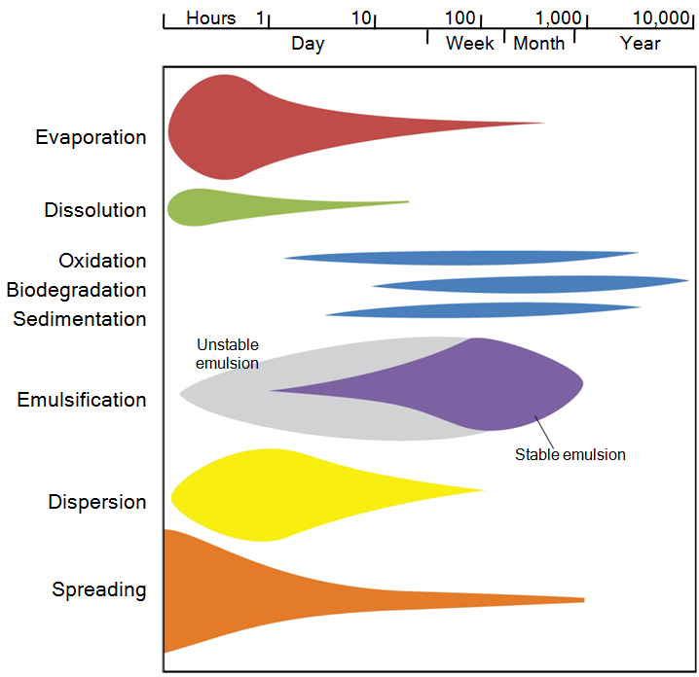
Weathering Processes Over Time
CGPRT(W) : Ensuring Clean Seas and Coasts in Western Region ……

Slide 8
Spreading
Oil will spread & fragment on sea surface occupying a larger area.
Thickness of oil layer on sea surface will decrease over time, except in cases where oil emulsifies.
This process affects oil recovery rates as:
  Thin oil layer is difficult to recover
  Lower encounter rate as oiled area is increasing
CGPRT(W) : Ensuring Clean Seas and Coasts in Western Region ……

Slide 9
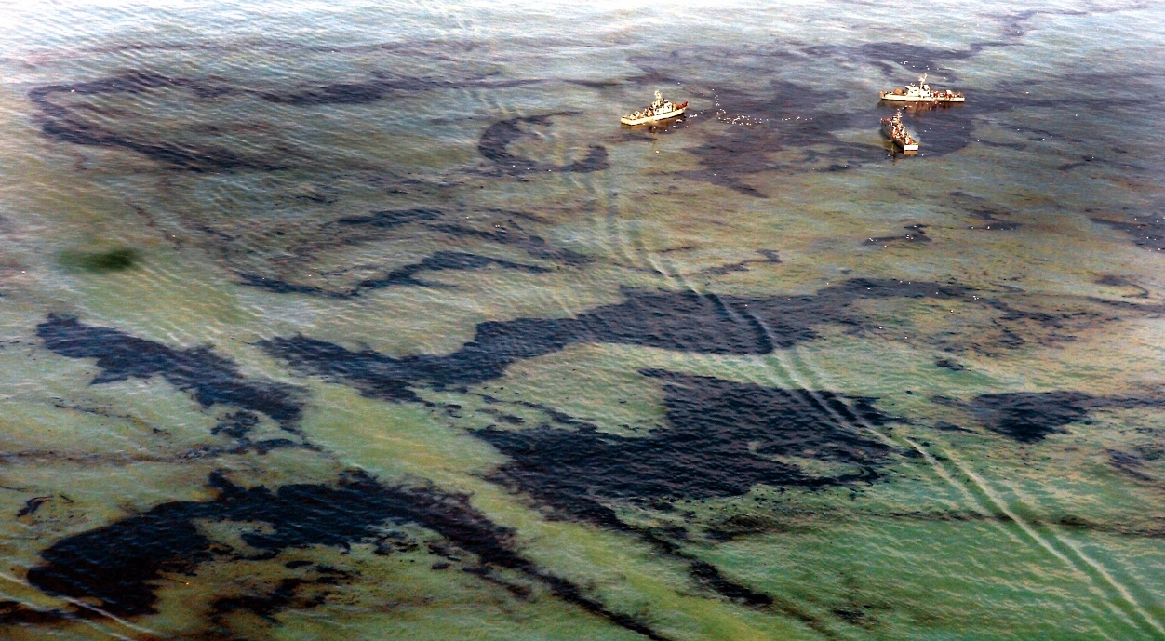
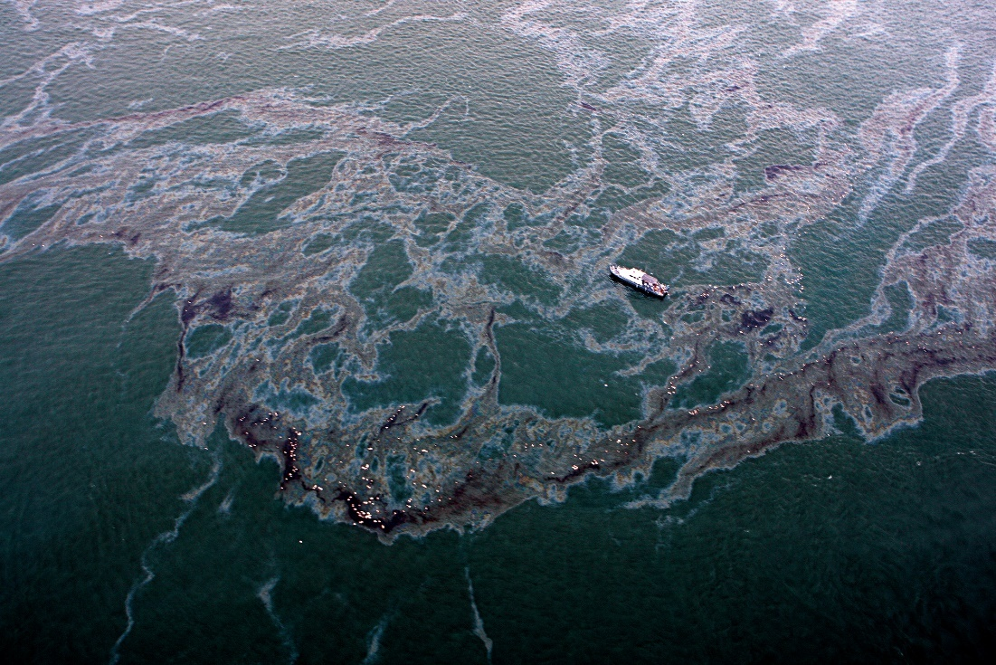
Spreading
CGPRT(W) : Ensuring Clean Seas and Coasts in Western Region ……

Slide 10
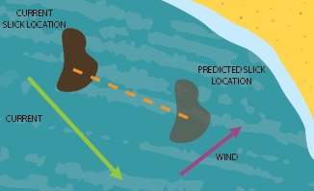
Drifting at Sea
Oil will drift at sea under the influence of currents and winds
100% current direction and speed, approximately 3% wind direction and speed
CGPRT(W) : Ensuring Clean Seas and Coasts in Western Region ……

Slide 11
Wind Effects
Wind
Wind
Wind
CGPRT(W) : Ensuring Clean Seas and Coasts in Western Region ……

Slide 12
Evaporation
Oil will release vapours in atmosphere.
Rate of emission will depend on ambient temperature, vapour pressure & concentration of volatile components.
Vapours are generally flammable and toxic (health and safety issue).
Evaporation will reduce volume of oil but increase oil viscosity.
CGPRT(W) : Ensuring Clean Seas and Coasts in Western Region ……

Slide 13
Emulsification
Water droplets can be incorporated into the oil layer by wave action forming an emulsion.
Can be stable or unstable
Asphaltene content is a good indication of an oil’s propensity to form stable emulsions (above 0.5%).
A major disadvantage for response:
  Increase oil viscosity
  Increase volume
CGPRT(W) : Ensuring Clean Seas and Coasts in Western Region ……

Slide 14
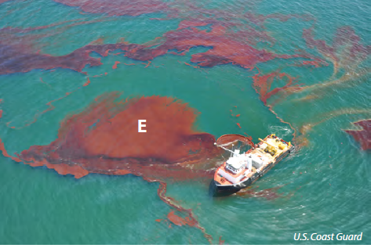
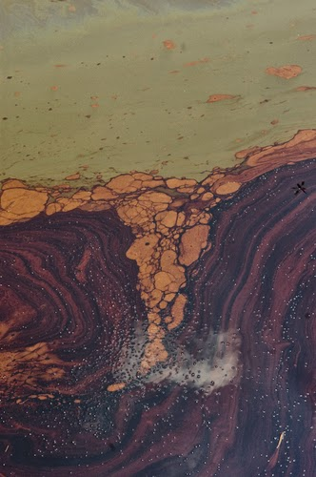
Emulsion
CGPRT(W) : Ensuring Clean Seas and Coasts in Western Region ……

Slide 15
Natural Dispersion
Oil droplets will be naturally entrained in water column by wave action breaking oil slick into small droplets.
Small droplets have propensity to remain in suspension in water column, facilitating dilution and biodegradation.
  Larger droplets will resurface to reform an oil slick
Chemical dispersion using dispersants will enhance natural dispersion by promoting formation of small droplets.
CGPRT(W) : Ensuring Clean Seas and Coasts in Western Region ……

Slide 16
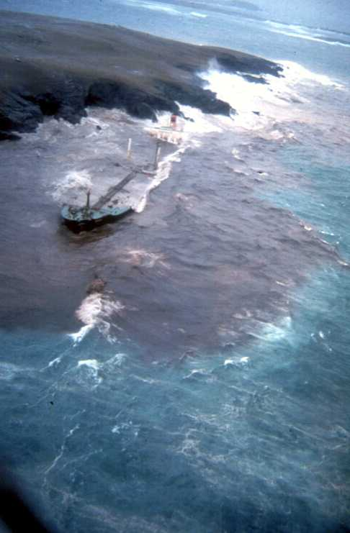
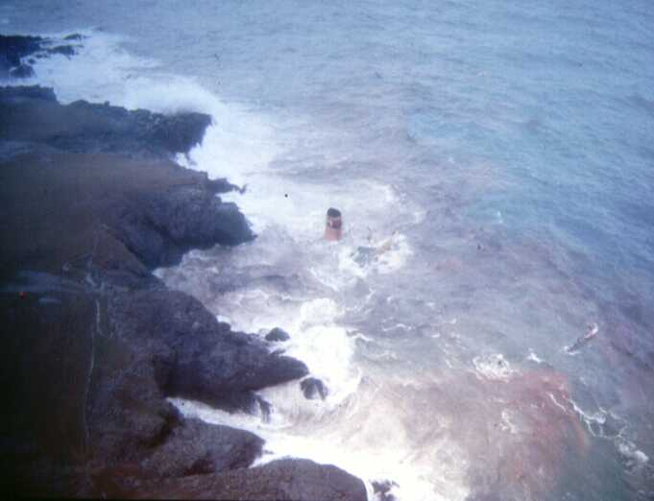
Natural Dispersion
Braer
Shetland Isles, UK, 1993
CGPRT(W) : Ensuring Clean Seas and Coasts in Western Region ……

Slide 17
Effects of Oil Weathering on Response
Safety
  Evaporation
Efficacy of response strategies
  Containment (e.g. spreading)
  In situ burning (e.g. losing ignitability by emulsification)
  Dispersants
  Skimmers
  Pumps
CGPRT(W) : Ensuring Clean Seas and Coasts in Western Region ……

Slide 18
Shoreline Interactions
In most cases, oil slicks will reach coast.
Oil can become stranded on shoreline.
This process will be affected by shoreline wave exposure and by type of substrate.
CGPRT(W) : Ensuring Clean Seas and Coasts in Western Region ……

Slide 19
Man-made Shorelines
  Oil will generally penetrate deeply into permeable shorelines such as riprap/concrete tetrapods which limits the weathering process
  Oil will adhere to impermeable shorelines (concrete or steel wharves, etc.) with little penetration
  Oil may become trapped under pilings
  Not considered sensitive shoreline
CGPRT(W) : Ensuring Clean Seas and Coasts in Western Region ……

Slide 20
Shoreline Interactions
Rocks and boulders
  Oil will generally penetrate deeply into permeable shorelines
  Deep penetration of oil limits the weathering process
CGPRT(W) : Ensuring Clean Seas and Coasts in Western Region ……

Slide 21
Shoreline Interactions
Pebbles and cobbles beaches
  Oil will generally stick to surface of sediments.
  Oil can penetrate into interstices between sediment material.
    Generally, low viscosity oils can penetrate deeper into sediments than heavy oils.
  Clean-up can be difficult due to penetration.
CGPRT(W) : Ensuring Clean Seas and Coasts in Western Region ……

Slide 22
Shoreline Interactions
Sand beaches
  Oil will generally remain on surface with minimal penetration – depending on surface grain size.
  Can be buried in layers by erosion and sand movements due to wind, waves or tides.
  Can mix with sand particles & sink in near shore environment or in intertidal zone.
  Can mix with fine mineral particles in intertidal zone forming small aggregates which will eventually be dispersed.
CGPRT(W) : Ensuring Clean Seas and Coasts in Western Region ……

Slide 23
Shoreline Interactions
Mud flats and marshes
  Generally, oil penetration is not observed as these sediments are very compact and often flooded.
    Walking or heavy equipment can push oil into the sediments.
    Oil can penetrate into muddy shorelines via animals’ burrows.
  Oil can stick to vegetation.
CGPRT(W) : Ensuring Clean Seas and Coasts in Western Region ……

Slide 24
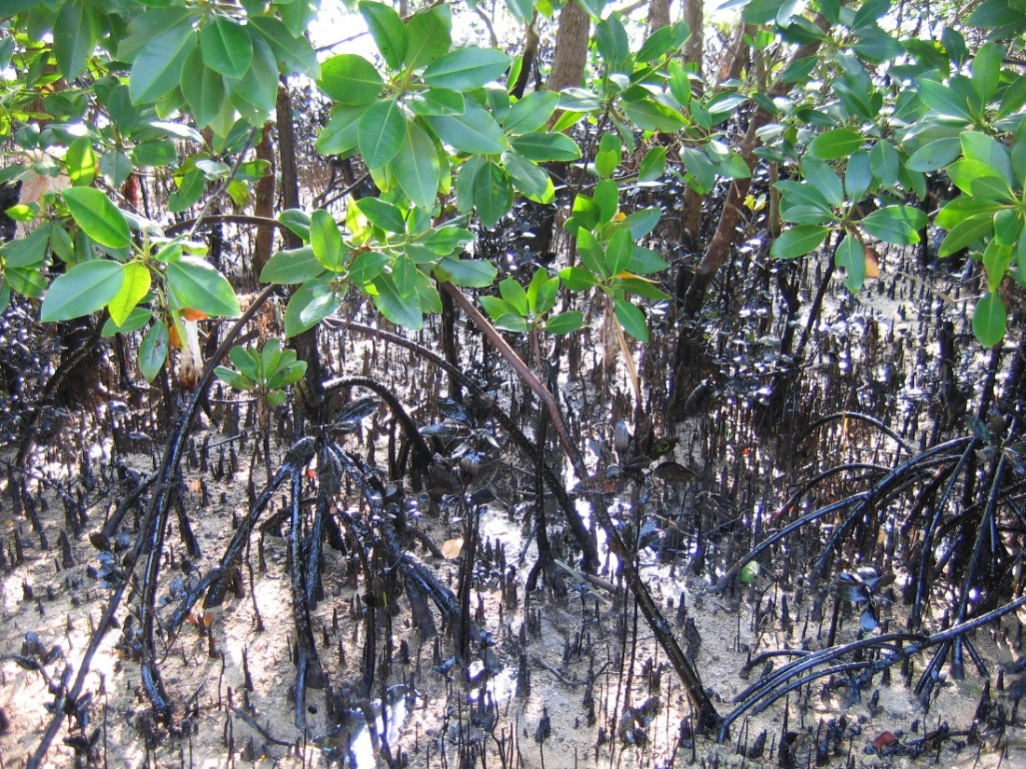
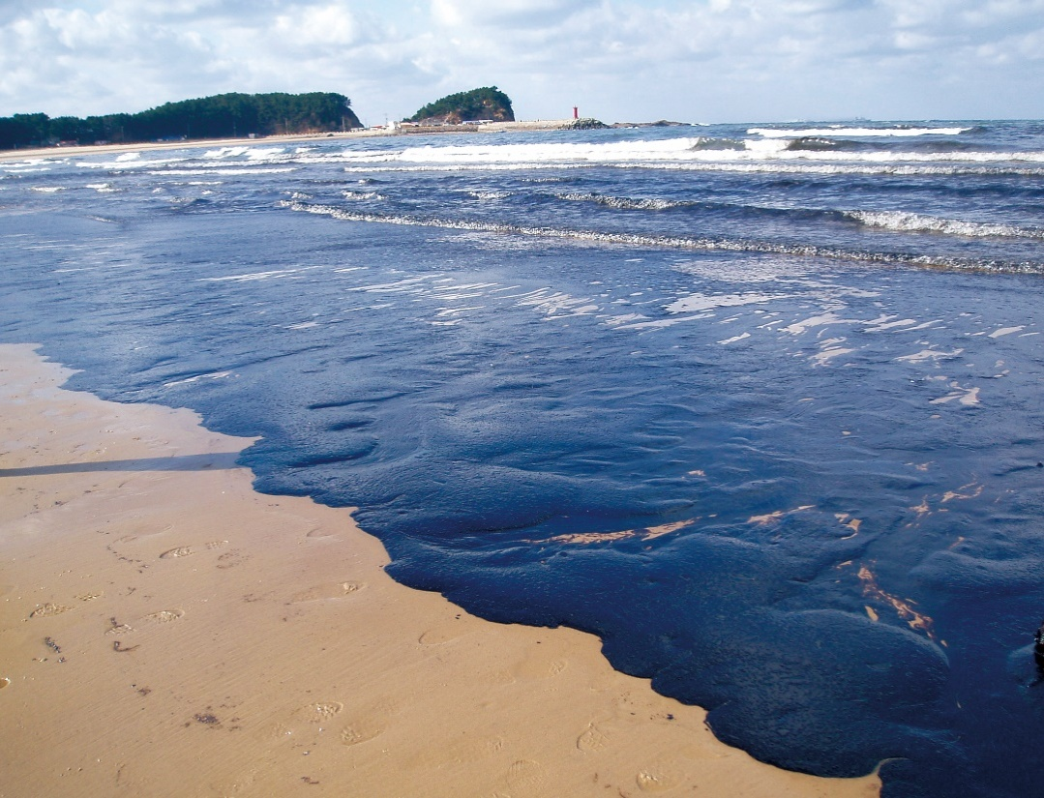
Shoreline Interactions
Source: ITOPF
Source: Korea Coast Guard
CGPRT(W) : Ensuring Clean Seas and Coasts in Western Region ……

Slide 25
Subsea releases
Subsea releases can occur from sunken vessels or from a well blowout.
Oil will rise to surface forming a surface oil slick that will be exposed to normal oil weathering processes.
  Oil can re-surface far from spill source due to horizontal currents, density stratification and vertical turbulence mixing.
Smaller oil droplets can remain in water column, be dispersed under influence of subsea currents & subject to biodegradation.
CGPRT(W) : Ensuring Clean Seas and Coasts in Western Region ……

Slide 26
Conclusion
Weathering processes will change oil properties over time.
Will have a direct impact on safety & operations on effectiveness of spill equipment & clean-up techniques.
CGPRT(W) : Ensuring Clean Seas and Coasts in Western Region ……

Slide 27
Any questions?
CGPRT(W) : Ensuring Clean Seas and Coasts in Western Region ……

